Slide 1
Digital Portfolio
STUDENT NAME: ISWARYALAKSHMI P
REGISTER NO AND NMID: autunm11024ca136
DEPARTMENT: B.C.A
COLLEGE: DRBCCC HINDU COLLEGE/ MADRAS UNIVERSITY

Slide 2
PROJECT TITLE
PORTFOLIO FOR WEB DEVELOPEMENT

Slide 3


AGENDA
Problem Statement
Project Overview
End Users
Tools and Technologies
Portfolio design and Layout
Features and Functionality
Results and Screenshots
Conclusion
Github Link
3/21/2024 Annual Review

Slide 4

PROBLEM STATEMENT
Lack of a personal platform to showcase skills and projects
Limited visibility for job opportunities and collaborations
Need for a modern, responsive, and attractive portfolio

Slide 5

PROJECT OVERVIEW
A personal portfolio website built with HTML, CSS, and JavaScript
Showcases profile, skills, and major projects
Designed with animations, responsiveness, and a clean UI

Slide 6

WHO ARE THE END USERS?
Recruiters and hiring managers evaluating profiles
Peers, mentors, and colleagues exploring work samples
General audience interested in design and development skills

Slide 7

TOOLS AND TECHNIQUES
HTML5 – Structure of the website.
CSS3 – Styling and responsive design.
JavaScript – Interactivity (form validation, animations).
Git & GitHub – Version control and project hosting.
VS Code – Development environment.

Slide 8
POTFOLIO DESIGN AND LAYOUT
Header – Name, tagline, navigation menu.
Sections – About, Skills, Projects, Contact.
Projects Section – Showcases real examples with descriptions.
Footer – Social links (LinkedIn, GitHub, Email).
Responsive Layout – Works on both desktop and mobile.
8

Slide 9
FEATURES AND FUNCTIONALITY
Smooth scrolling navigation.
Responsive design for mobile & desktop.
Interactive project cards.
Contact form with validation.
Integrated social media & GitHub links.
Simple and clean UI for better user experience.

Slide 10
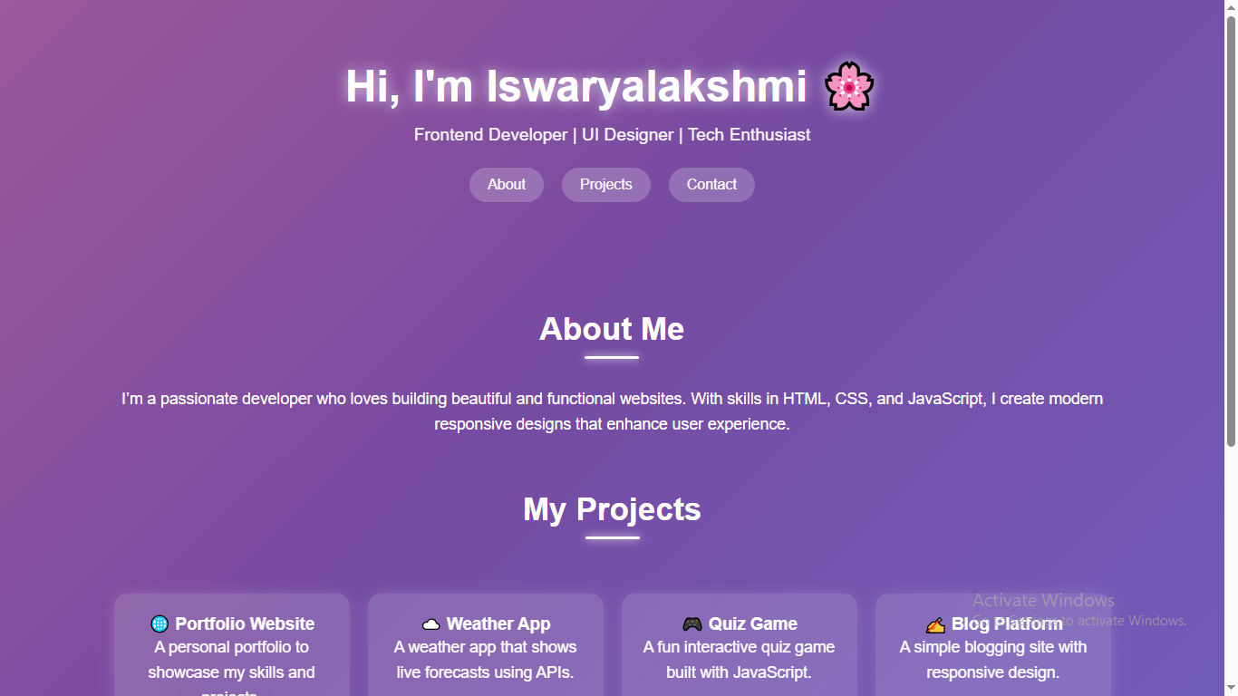

RESULTS AND SCREENSHOTS
3/21/2024 Annual Review
10

Slide 11
CONCLUSION
Achieved an engaging platform to present skills.
Improved confidence in web development skills.
Ready to share portfolio with potential opportunities.
11

Slide 12
Github Link
https://github.com/iswaryapavi1011/TNSDC-FWD-DP.git

